Slide 1
Data Communication and
Networks
Dr. S. Sathya Priya

Slide 2
Network Layer
Routing in Packet Networks

Slide 3
Overview
Introduction
Routing Algorithm Classification
Routing Tables

Slide 4
Introduction
One of the most complex and crucial aspects of packet-switching network design is routing.
Routing is the important duty of the network layer.
Routing is needed to guarantee that a packet from one palace to another.
Network layer in the Internet model is responsible for carrying packet from one computer to another.
The primary function of a packet-switching network is to accept packets from a source station and deliver them to a destination station.

Slide 5
Requirements for Routing function:
        Correctness
        Simplicity
        Robustness
        Stability
        Fairness
        Optimality
        Efficiency

Slide 6
Requirements for Routing function
first two items on the list are self-explanatory.
Robustness has to do with the ability of the network to deliver packets via some route in the face of localized failures and overload.
A tradeoff also exists between fairness and optimality.
Some performance criteria may give higher priority to the exchange of packets between nearby stations compared to an exchange between distant stations.
Finally, any routing technique involves some processing overhead at each node and often a transmission overhead as well, both of which impair network efficiency.
The penalty of such overhead needs to be less than the benefit accrued based on some reasonable metric, such as increased robustness or fairness.

Slide 7
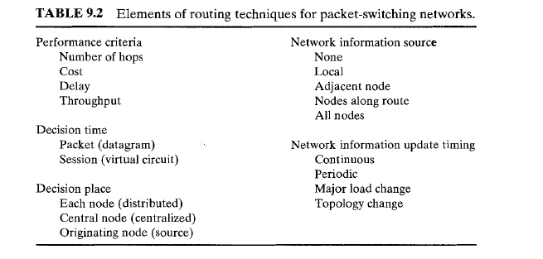
Elements of routing techniques for packet-switching networks
various design elements that contribute to a routing strategy.
Some of these categories overlap or are dependent on one another.

Slide 8
Performance Criteria
The selection of a route is generally based on some performance criterion.
simplest criterion is to choose the minimum-hop route through the network; this is an easily measured criterion and should minimize the consumption of network resources.
A generalization of the minimum-hop criterion is least-cost routing.
In this case, a cost is associated with each link, and, for any pair of attached stations, the route through the network that accumulates the least cost is sought.

Slide 9
Decision Time and Place
Routing decisions are made on the basis of some performance criterion.
Two key characteristics of the decision are the time and place that the decision is made.
Decision time is determined by whether the routing decision is made on a packet or virtual-circuit basis.

Slide 10
Decision Time and Place
internal operation of the network is datagram, a routing decision is made individually for each packet.
internal virtual- circuit operation, a routing decision is made at the time the virtual circuit is established.
In the simplest case, all subsequent packets using that virtual circuit follow the same route.
In more sophisticated network designs, the network may dynamically change the route assigned to a particular virtual circuit in response to changing conditions (e.g., overload or failure of a portion of the network).

Slide 11
term decision place refers to which node or nodes in the network are responsible for the routing decision.
Most common is distributed routing, in which each node has the responsibility of selecting an output link for routing packets as they arrive.
For centralized routing, the decision is made by some designated node, such as a network control center.
The danger of this latter approach is that the loss of the network control center may block operation of the network.
The distributed approach is perhaps more complex, but is also more robust.

Slide 12
decision place
A third alternative, used in some networks, is source routing.
In this case, the routing decision is actually made by the source station rather than by a network node, and is then communicated to the network.
This allows the user to dictate a route through the network that meets criteria local to that user.

Slide 13
Network Information Source and Update Timing
Most routing strategies require that decisions be based on knowledge of the topology of the network, traffic load, and link cost.
some strategies use no such information and yet manage to get packets through
flooding and some random strategies are in this category.
        Distributed
        Centralized

Slide 14
Routing in Packet Networks
packet switching network providing communication services among multiple nodes.
Good routing algorithms depend on the objective function that one is trying to optimize.
Generally a routing algorithm should seek one or more of the following goals:

Slide 15
Routing in Packet Networks
Rapid and accurate delivery of packets: algorithm should not take an unreasonable long time to find the path to the destination.
Adaptability to changes in network topology resulting from node or link failures: must be able to adapt and reconfigure the paths automatically when equipment fails.
Adaptability to varying s-d traffic loads: would be able to adjust the paths based on the current traffic loads.
Ability to route packets away from temporarily congested links.
Ability to determine the connectivity of the network:
Ability to avoid routing loops: In consistent information un distributed computation may lead to routing tables that create routing loops. .
Low overhead: systems obtain the connectivity information by exchanging control messages with other routing systems.

Slide 16
Routing Algorithm Classification
One can classify routing algorithms in several ways.
Based on their responsiveness, routing can be
        static
        dynamic (or adaptive).

Slide 17
Static routing
static routing paths are pre computed based on the network topology, link capacities, and other information.
The computation is typically performed offline by a dedicated host.
When the computation is completed, the paths are loaded to the routing table and remain fixed for a relatively long period of time.
Static routing may suffice if the network size is small
biggest disadvantage of static routing is its inability to react rapidly to network failures.

Slide 18
Dynamic (adaptive) routing
dynamic (adaptive) routing each node continuously learns the state of the network by communicating with its neighbors.
Thus a change in a network topology is eventually propagated to all nodes.
Based on the information collected, each node can compute the best paths to desired destinations.
One disadvantage of dynamic routing is the added complexity in the node.
Routing algorithm can be centralized or distributed.

Slide 19
centralized routing
centralized routing a network control center computer all paths and then uploads this information to the nodes in the network.

Slide 20
Distributed routing
distributed routing nodes cooperate by means of message exchanges and perform their own routing computations.
Distributed routing algorithms generally scale better than centralized algorithms but are more likely to produce inconsistent results.
Routing decisions can be made on a per packet basis or during the connection setup time.
With virtual-circuit packet switching, the path (virtual circuit) is determined during the connection setup phase.
Datagram packet switching does not require a connection setup.
The path followed by each packet is determined independently by the routing table in each node.

Slide 21
Routing Tables
Once the routing algorithm has determined the set of paths, the path information is stored in the routing table so that each node (switch or router) knows how to forward packets.
With vc packet switching, the routing table translates each incoming VCI to an outgoing VCI and identifies the output port to which to forward a packet based on the incoming VCI of the packet.
With datagram packet switching, the routing table identifies the next hop to which to forward a packet based on the destination address of the packet.

Slide 22
Hierarchical Routing
The size of the routing tables that routers need to keep can be reduced if a hierarchical approach is used in the assignment of addresses.
Essentially, hosts that are near each other should have addresses that have common prefixes.
In this way routers need to examine only part of the address (i.e., the prefix) in order to decide how a packet should be routed.

Slide 23
FLOODING
simple routing technique.
technique requires no network information whatsoever, and works as follows.
A packet is sent by a source node to every one of its neighbors.
At each node, an incoming packet is retransmitted on all outgoing links except for the link on which it arrived.
The principle of Flooding calls for a packet switch to forward an incoming packet to all ports except the one the packet was received from.
If each packet switch performs this flooding process, the packet will eventually reach the destination as long as at least one path exists between the source and the destination.

Slide 24
FLOODING
effective routing approach when the information in the routing tables is not available, such as during system startup, or when survivability is required, such as in military networks.
also effective when the source needs to send a packet to all nodes connected to the network (i.e., broadcast delivery).
We will see that the link- state routing algorithm uses flooding to distribute the link- state information to other nodes in the network.

Slide 25
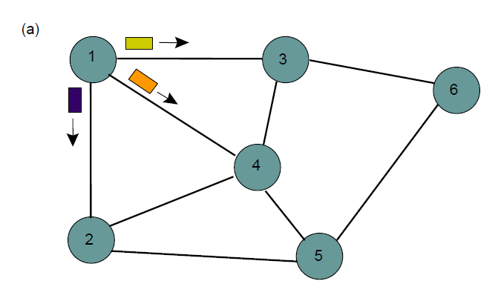

Slide 26
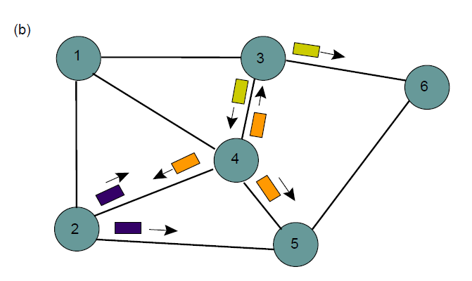

Slide 27
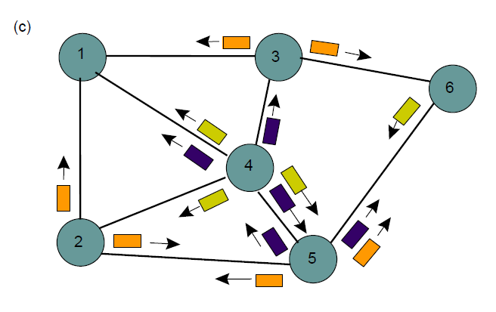

Slide 28
First method
First method is to use a time-to-live (TTL) field in each packet.
When the source sends a packet, the TTL is initially set to some number.
Each node decrements the TTL by one before flooding the packet.
If the value reaches zero, the node discards the packet.
To avoid unnecessary waste of bandwidth, the TTL should ideally be set to the minimum hop number between two furthest nodes (called the diameter of the network).

Slide 29
Second method
second method, each node adds its identifier to the header of the packet before it floods the packet.
When a node receives a packet that contains the identifier of the node, it discards the packet since it knows that the packet already visited the node before.
This method effectively prevents a packet from going around a loop.

Slide 30
Third method
third method is similar to the second method in that they both try to discard old packets.
The only difference lies in the implementation. Here each packet from a given source is identified with a unique sequence number.

Slide 31
SHORTEST-PATH ROUTING
Many routing algorithms are based on variants of shortest-path algorithms, which try to determine the shortest path according to some cost criterion.
To better understand the purpose of these algorithms, consider a communication network as a graph consisting of a set of nodes (or vertices) and a set of links (or edges), where each node represents a packet switch and each link represents a transmission line between two packet switches.

Slide 32
Cost ~ 1/capacity:
The cost is inversely proportional to the link capacity. Here one assigns higher costs to lower-capacity links.
The objective is to send a packet through a path with the highest capacity.
If each link has equal capacity, then the shortest path is the path with the minimum number of hops.

Slide 33
Cost ~ packet delay
The cost is proportional to an average delay, which includes queuing delay in the switch buffer and propagation delay in the link.
The shortest path represents the fastest path to reach the destination.

Slide 34
Cost ~ congestion
The cost is proportional to some congestion measure, for example, traffic loading. Thus the shortest path tries to avoid congested links.

Slide 35
Dynamic Routing
networks generally use dynamic routing algorithms rather than the static ones because static algorithms do not take the current network load into account.
forwarding tables are continuously updated with the information received from other routers.
Two dynamic algorithms namely,
        distance vector routing and
        link state routing

Slide 36
Distance vector routing Algorithm
distributed Bellman-Ford routing algorithm and the Ford-Fulkerson algorithm, after the researchers who developed it (Bellman, 1957; and Ford and Fulkerson, 1962).
It was the original ARPANET routing algorithm
used in the Internet under the name RIP.
algorithms operate by having each router maintain a table (i.e, a vector) giving the best known distance to each destination and which line to use to get there.
routing tables are updated by exchanging information with the neighbors.

Slide 37
DV(contd..)
Each router maintains a routing table indexed by, and containing one entry for, each router in the subnet.
The entry contains two parts:
  preferred outgoing line to use for that destination and
  Estimate of the time or distance to that destination.
The router is assumed to know the ''distance'' to each of its neighbors.
Distance is a routing metric that can have different types of meanings but it is usually the hop count.

Slide 38
DV(contd..)
metric is hops, the distance is just one hop.
metric is queue length, the router simply examines each queue.
metric is delay, the router can measure it directly with special ECHO packets that the receiver just timestamps and sends back as fast as it can.

Slide 39
DISTANCE VECTOR ROUTING ALGORITHM
Operation:
Each router maintains a routing table indexed by, and containing one entry for, each router in the subnet.
This entry contains two parts:
The preferred outgoing line to use for that destination
An estimate of the time or distance to that destination.
The metric used might be number of hops; time delay in milliseconds; total number of packets queued along the path, etc

Slide 40
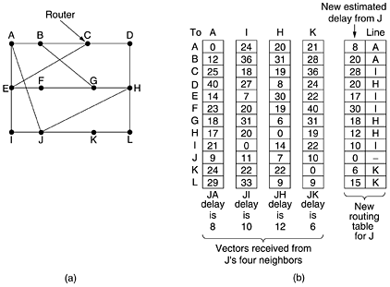

DISTANCE VECTOR ROUTING ALGORITHM
The below figure shows (a) A subnet, (b) show the delay vectors received from the neighbors of router J.
A claims to have a 12-msec delay to B, a 25-msec delay to C, a 40-msec delay to D, etc.
Suppose J has measured or estimated its delay to its neighbors, A, I, H, and K as 8, 10, 12 & 6 ms, resp.

Slide 41
DISTANCE VECTOR ROUTING ALGORITHM
Computation of J’s new route to router G:
Case 1: Via A
J can get to A in 8 ms and A claims to get to G in 18 ms, so J can count on a delay of 26 (8 + 18) ms to G.
Case 2: Via I
J can get to I in 10 ms and I claims to get to G in 31 ms, so J can count on a delay of 41 (10 + 31) ms to G.
Case 3: Via H
J can get to H in 12 ms and H claims to get to G in 6 ms, so J can count on a delay of 18 (12 + 6) ms to G.
Case 4: Via K
J can get to K in 6 ms and K claims to get to G in 31 ms, so J can count on a delay of 37 (6 + 31) ms to G.
The least of all cases is 18.
Therefore, J makes an entry in its routing table that the delay to G is 18 msec and that the route to use is via H.

Slide 42
DISTANCE VECTOR ROUTING PROTOCOL
These protocols advertise a small amount of simple information about each subnet to their neighbors.
Their neighbors in turn advertise the information to their neighbors, and so on, until all routers have learned the information.
This process continues in a periodic basis.
Distance vector protocols send full updates each time they send a regular periodic routing update.
So these routing updates are called PERIODIC FULL ROUTING UPDATES.

Slide 43
DISTANCE VECTOR ROUTING PROTOCOL
As long as there is no change with the same metrics, there is no change in the routers routing table. When change occurs, the routers react and converge to use the new best working routes.
Distance vector protocols must define a METRIC that determines how good each is. The metric represents a distance from a router to a subnet.
Features:
Simple
Uses little bandwidth
Designed to send only little information

Slide 44
ROUTING INFORMATION PROTOCOL – RIP
RIP is a distance vector routing protocol.
RIP sends periodic routing updates every 30 seconds by default.
Metric Used: Hop Count
Hop Count: The number of routers or hops between a router and the destination subnet.
Metric considered to be “infinite” : 16
RIP response message:
Routing updates are exchanged between neighbors approximately every 30 seconds using a so-called RIP response messages.
Also known as RIP advertisements.

